Slide 1
Summary
04/13/2022

Slide 2
Simulator Recording/ Playback
Where to find code: https://github.com/LauraConnolly/volumetric_drilling
Contact info: 15lpc1@queensu.ca

Slide 3
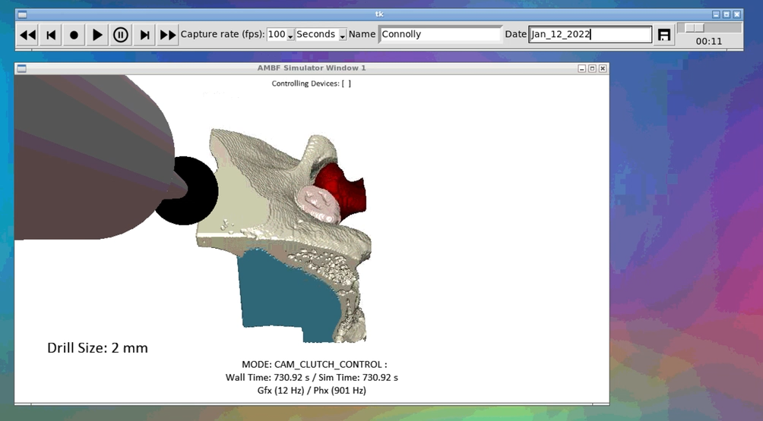
Simulation widget
Enables recording and basic playback functionality
Saving/ organization system based on name and date

Slide 4
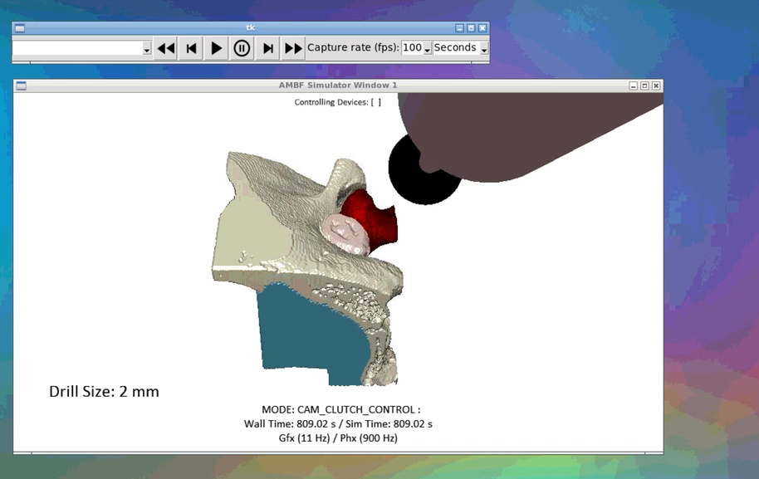
Playback widget
Linked to saved session directory
Enables basic playback functionality

Slide 5
Virtual Reality Improvement
Goal: Test LPMS-B2 IMU use for position tracking/ add position tracking to volumetric drilling simulator so surgeon can walk around freely
Where to find code: https://github.com/LauraConnolly/volumetric_drilling
Contact info: 15lpc1@queensu.ca

Slide 6
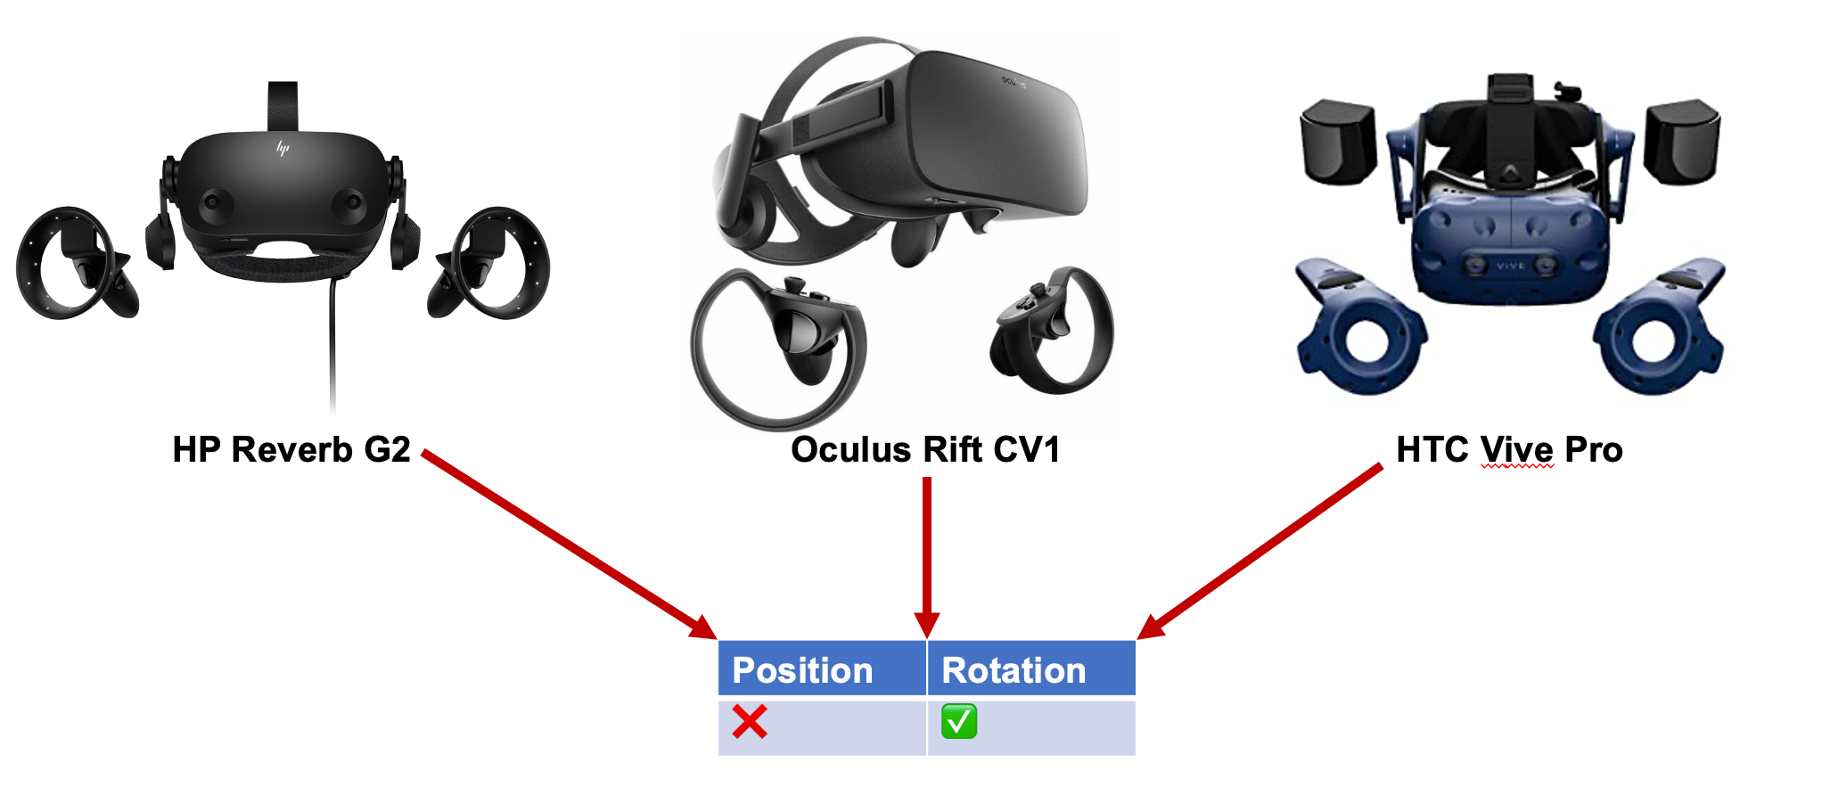
Problem definition
3 different VR headsets
Linux API can give us rotation but not position
This means the surgeon can rotate their head, but they can’t walk around during the simulation
1/2

Slide 7
Approach
Research other APIs to see if there is something else available that can give us access to the internal position sensors
Implement position tracking with wireless IMU and evaluate the accuracy to see if this is viable for the simulator

Slide 8
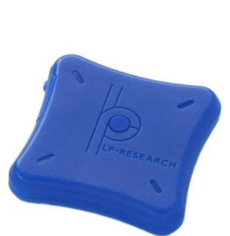
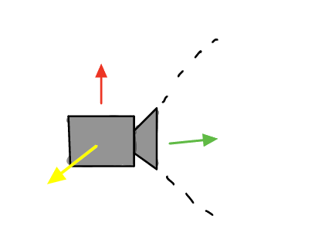
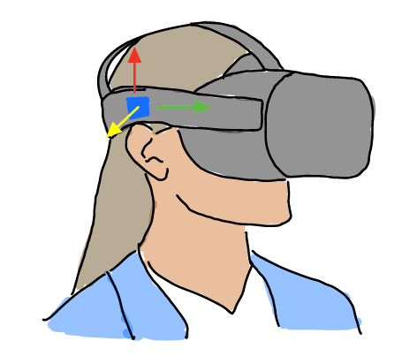
Positional tracking for VR headset with Bluetooth IMU
Bluetooth IMU sensor
IMU sensor mounted to headset
Simulator
Bluetooth sensor will give positional tracking info about the VR headset, which will be used to control the position of the camera in the simulator

Slide 9
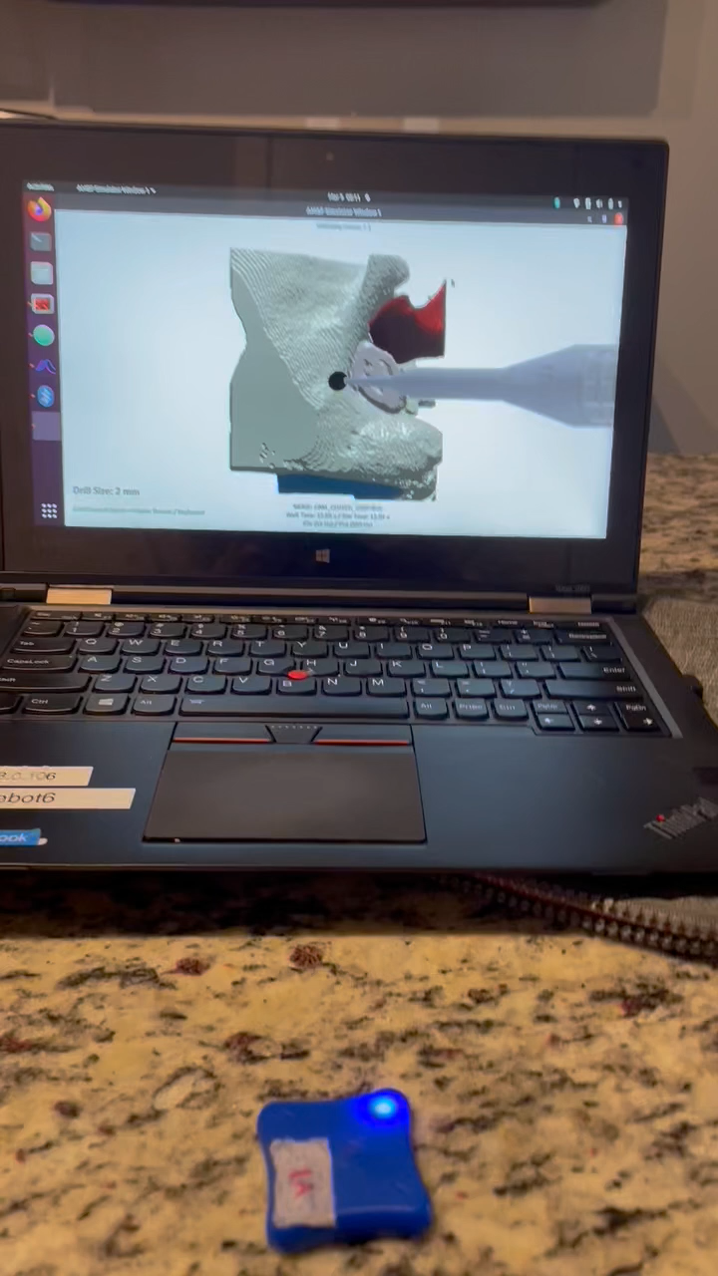
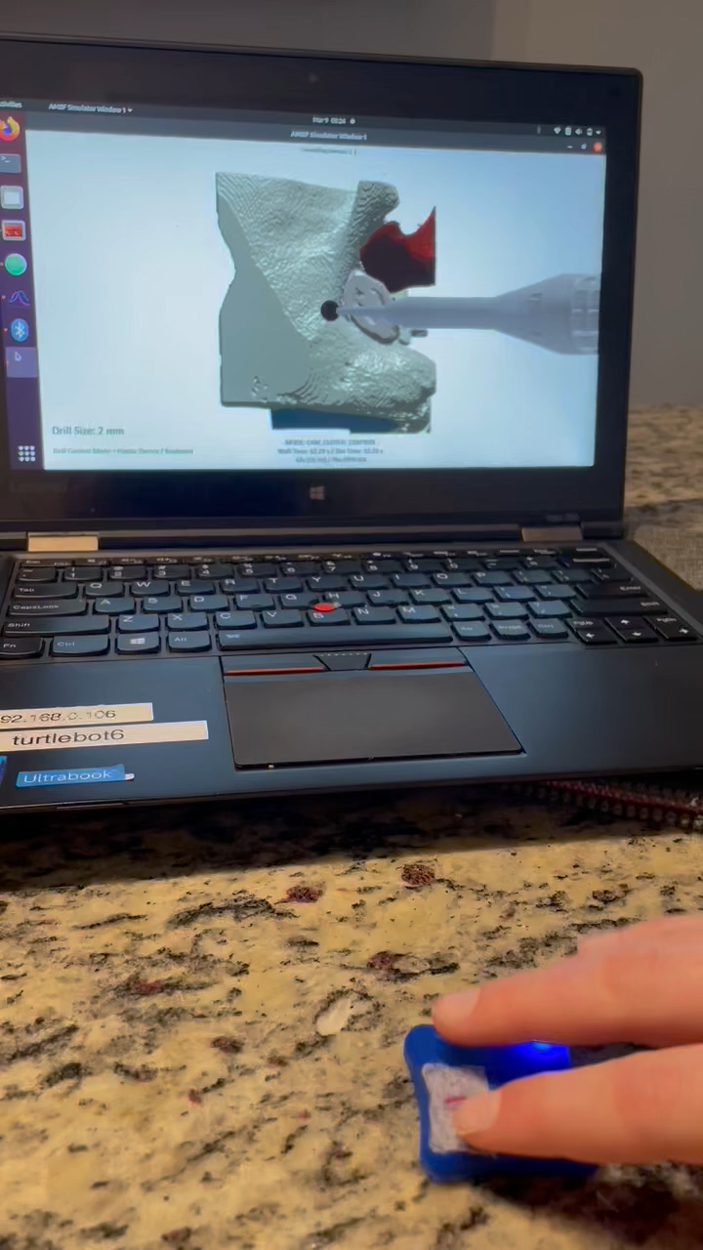


Slide 10
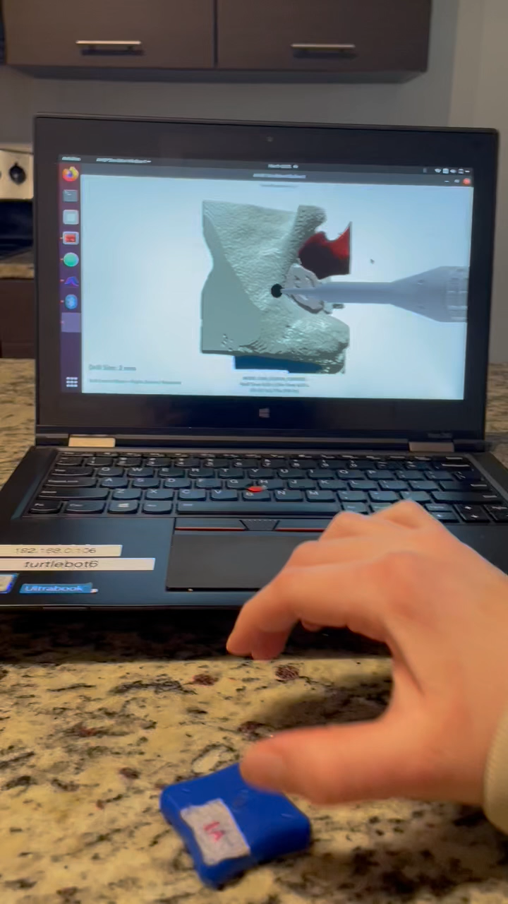
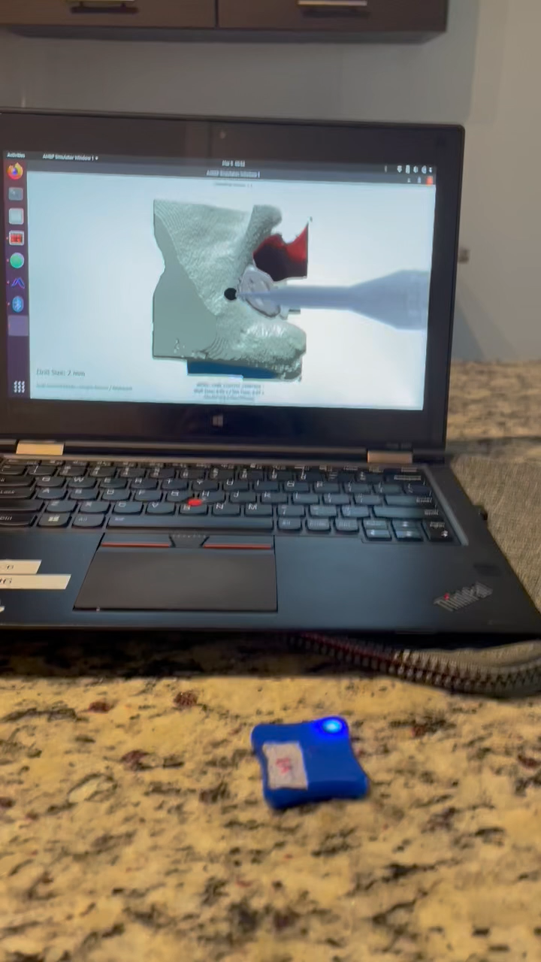

Slide 11
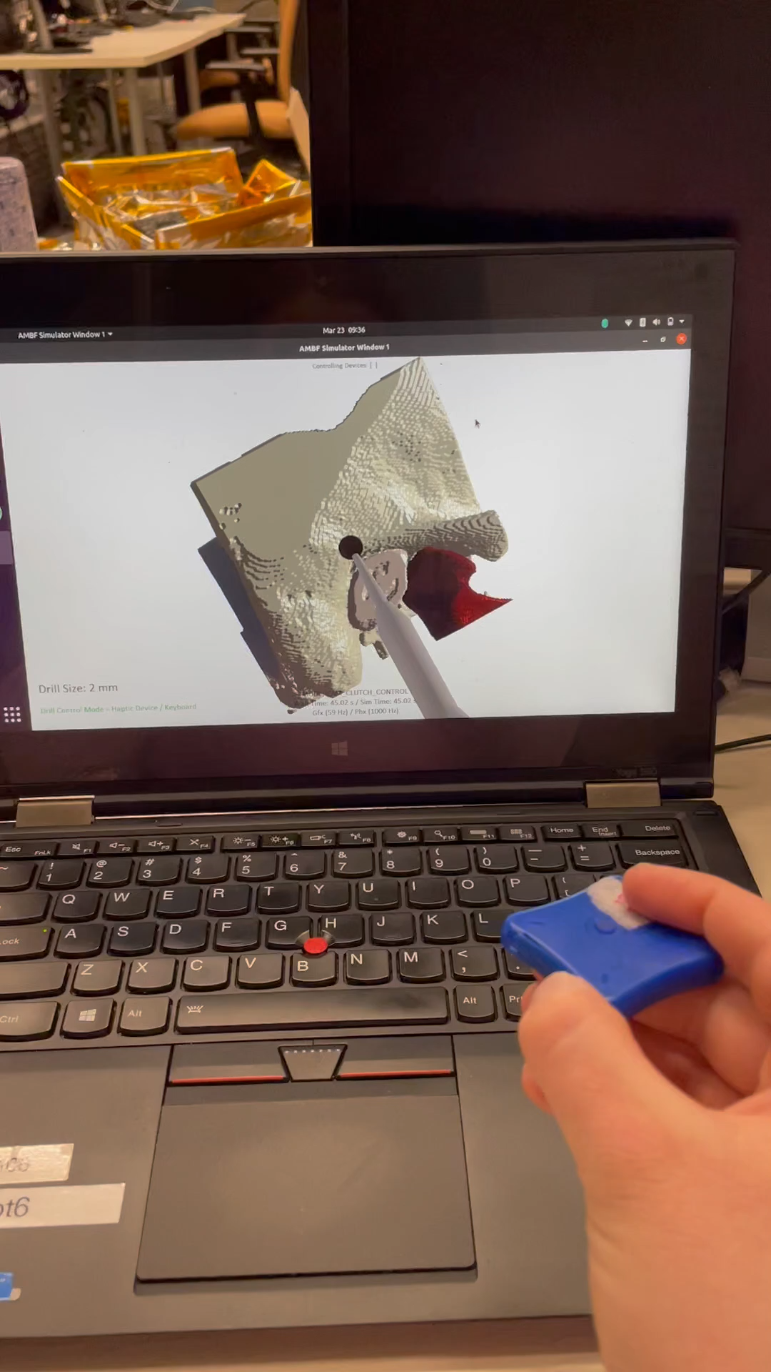
IMU for orientation

Slide 12
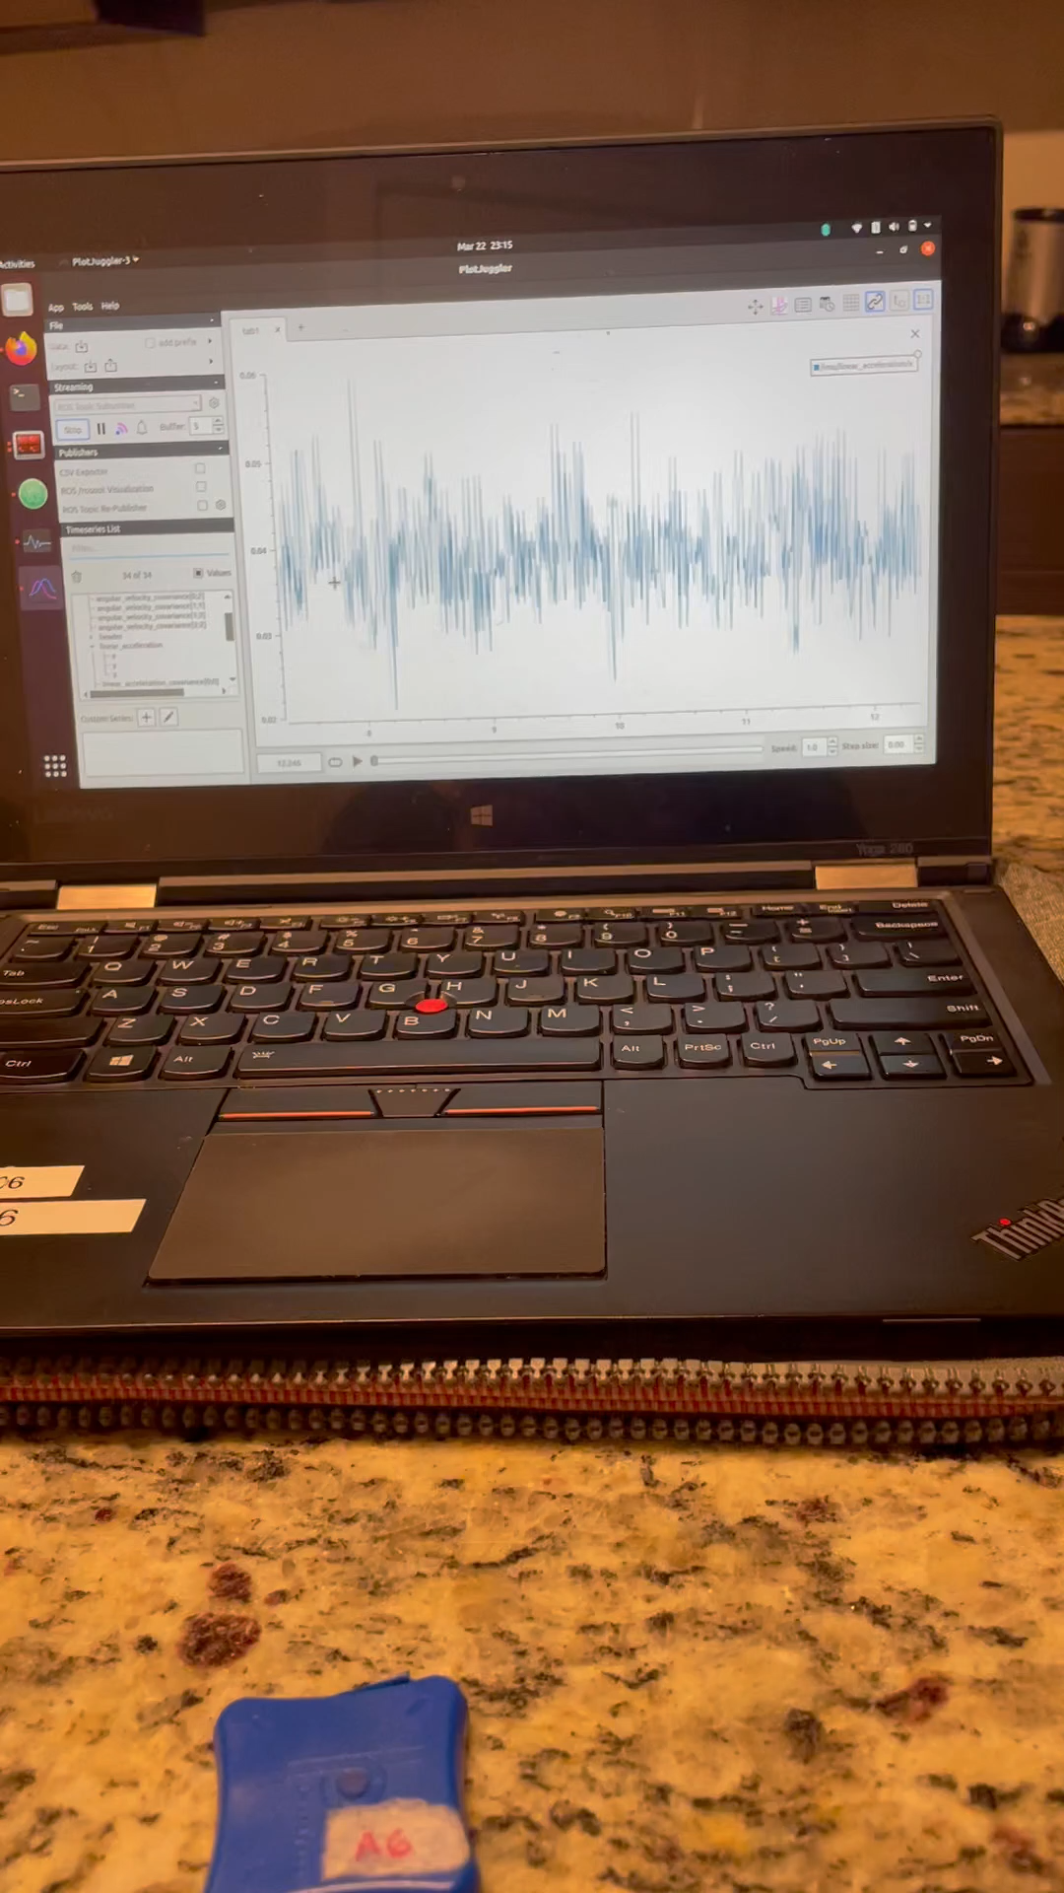
Discoveries
Starting evaluating positioning accuracy and realized an issue with directional sensor noise when moving slowly (linear acceleration)
Seems to work when the sensor has high acceleration
Conclusion:
Tabling the integration position tracking but saving the code and these findings for reference

Slide 13
Conclusion
IMU position tracking works if they’re move quickly
Too much noise when the device is at rest to use them for generic position tracking (ie. if the surgeon is moving slow the accuracy will be bad)

